Slide 1
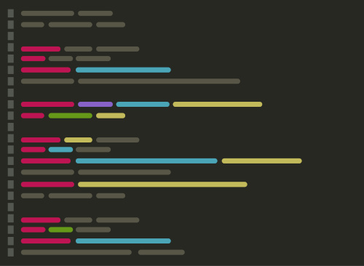
ECS 351L and 851L: Geospatial Data Science
Lecture 1: Introduction

Slide 2
Welcome
Dr. Johnny Ryan, Assistant Professor
BSc in Geography, University of Nottingham, UK
MPhil in Polar Studies, University of Cambridge, UK
PhD in Geography, Aberystwyth University, UK
Postdoc, Institute at Brown for Environment and Society, RI, USA
Assistant Professor, University of Oregon, OR, USA
Researching glaciology, hydrology, remote sensing
Email: jonathan.ryan@duke.edu
Office: Grainger Hall 3101
Office hours: Monday 15:00-16:00 and Wednesday 15:00-16:00

Slide 3
Overview
What is Geospatial Data Science?
Spatial data (e.g. geometries and projections)
Coding (e.g. Python, bash)
Collaborating (e.g. version control, git, GitHub)
Course
Lectures, activities, homework, grading
Canvas vs. course website
OneDrive
Final project
Some tasks
Check access to Canvas and links within
Get started on homework for this week

Slide 4
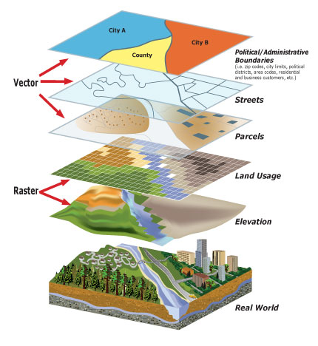
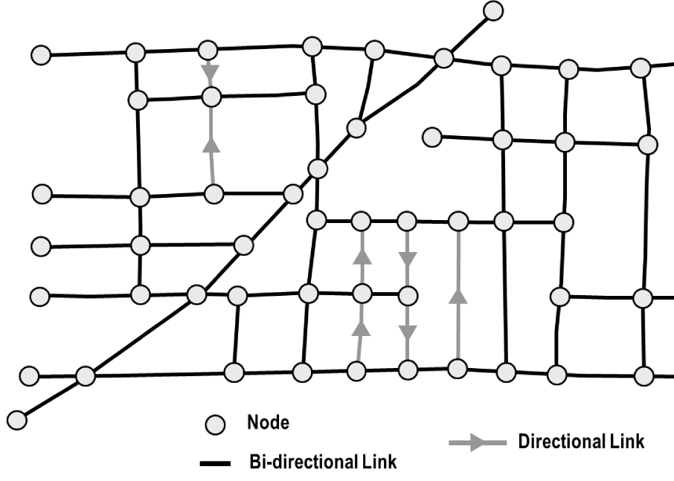
Geospatial data
Vector data
Network data
Raster data
Notes:
Geometries, projections, grid cell size, network data has nodes and paths

Slide 5
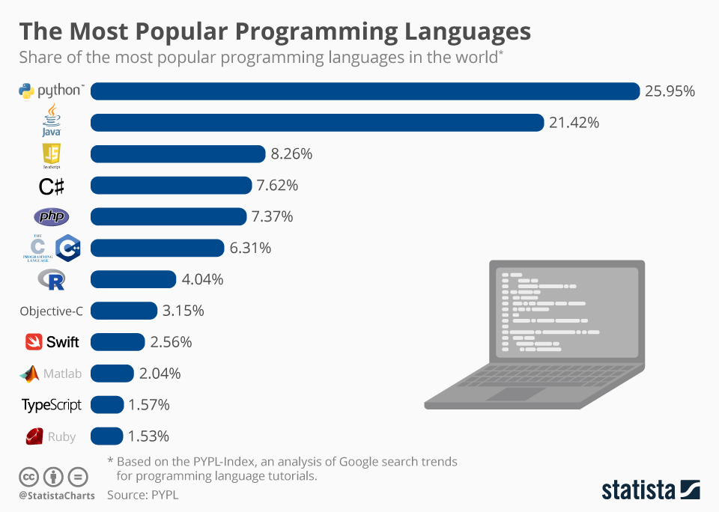

Python
Popular high-level programming language
Easy-to-read
Extensive and mature libraries
Free and open-source
Accessible
Can be examined, modified, and improved
Constantly evolving
Notes:
We need flexible tools to process, analyze, and visualize data. This may seem like a superficial point, but it is crucial for effective sharing of code. Even if you are the only one reading your code, python is easy on the eyes. Provides the tools to do almost anything you can imagine. If we want to have transparent, reproducible, scientific results, we should be using open source tools. Unlike MATLAB or ArcGIS. The world is changing: data is exploding, computers architecture is evolving, and new forms of analysis and visualization are being invented. Python is evolving too, and it evolves based on what the community needs.

Slide 6


Git and GitHub
Git
Version control software for tracking changes to a set of files
GitHub
A cloud-based Git repository hosting service
Makes it easier to coordinate work among programmers collaboratively developing source code during software development
Python and projects that use Python (e.g. matplotlib) are all maintained and developed by a community of scientists and programmers on GitHub
An active, up-to-date GitHub profile, with contributions to open-source project is a great way to provide evidence of skills
Notes:
Some of whose work is supported by universities, non-profits, and for-profit corporations.

Slide 7
Course schedule
Lectures: Monday @ 1:25pm in LSRC A156
Thirteen lectures
Activities: Wednesday @ 1:25pm in LSRC A156
Eleven activities (no activity first week and miss one because of Thanksgiving)
Submit same day by 11:59pm on Canvas
Homework: due following Wednesday by 11:59pm
Seven assignments
Submit on Canvas
Notes:
We have a lot to cover

Slide 8
Course schedule
Lectures: Monday @ 1:25pm in LSRC A156
Thirteen lectures
Activities: Wednesday @ 1:25pm in LSRC A156
Eleven activities (no activity first week and miss one because of Thanksgiving)
Submit same day by 11:59pm on Canvas
Homework: due following Wednesday by 11:59pm
Seven assignments
Submit on Canvas
Notes:
We have a lot to cover

Slide 9
Course schedule
Lectures: Monday @ 1:25pm in LSRC A156
Thirteen lectures
Activities: Wednesday @ 1:25pm in LSRC A156
Eleven activities (no activity first week and miss one because of Thanksgiving)
Submit same day by 11:59pm on Canvas
Homework: due following Wednesday by 11:59pm
Seven assignments
Submit on Canvas
Notes:
We have a lot to cover

Slide 10
Course evaluation
Assignments (45%): Submit weekly assignments on Canvas (see instructions in Lab #1). Assignments are due a week after they are set (i.e. the following Wed 11:59 pm).
Activities (15%): Submitted through Canvas. The deadline for activities will be the same day that they are set (i.e. Wed 11:59 pm).
Final project (30%): An essential component of this course is the final project which provides an opportunity to explore a particular topic of interest using some of the skills developed in this course. Students will present project during the week starting Dec 1 and submit a write up by Dec 5 11:59 pm.
Engagement (10%): Graded by instructor. Credit can be earned through attendance, participation in class discussion, visiting Professor during office hours, and helping other students with assignments.
Notes:
We have a lot to cover

Slide 11
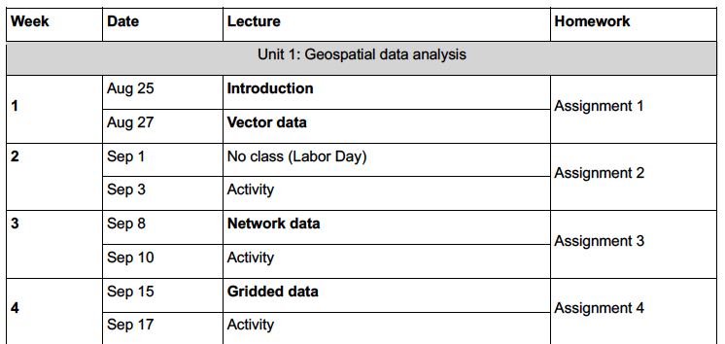
Course schedule
Notes:
We have a lot to cover – four units

Slide 12
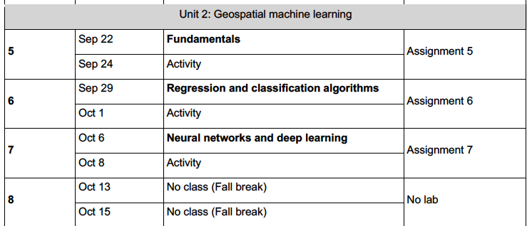
Course schedule

Slide 13
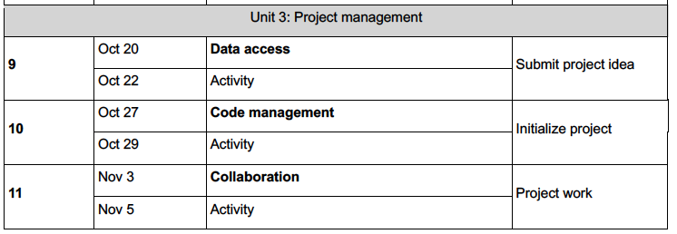
Course schedule

Slide 14
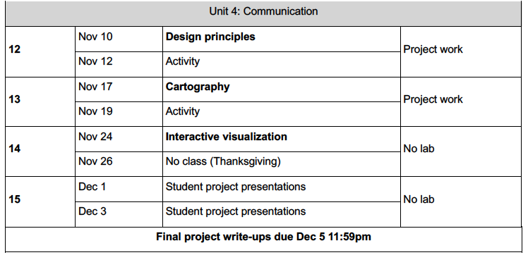
Course schedule

Slide 15
Canvas vs. course website
Course website: https://ryan-lab-duke.github.io/gds-applications-site/intro.html
(not completely finished)
Links to syllabus, schedule, homework, deadlines will also be on Canvas
Submit assignments and activities to Canvas as PDFs
Data for assignments will be available on OneDrive (links will be on course website)
Access through Duke email account
Notes:
Mostly use Canvas to organize my grading, set assignment deadline etc.

Slide 16
Final project
An opportunity to explore a particular topic of interest using some of the skills developed in this course
Students can work independently but would prefer to see groups of two or three
Sharing of project ideas is encouraged so we can form teams
Undergraduate students will conduct a contained research project (e.g. that replicates a single peer-reviewed journal article) and present it to the class orally.
Graduate students will be expected to undertake a substantive final project that critically engages with current research, knowledges gaps, or debates in their field of interest. As well as an oral presentation, graduate students will be expected to write a short research paper based on the finding of their project.

Slide 17
Final project schedule
Week 9 (after Fall Break): Discuss project ideas with peers and instructor, submit a short summary of a project idea to instructor via Canvas
Week 10: Form teams, create GitHub repo, and provide some basic info about project as a README.md
Week 12: Provide informal update to instructors, ensure data has been accessed, goals are accomplishable
Week 15: Present project to class and submit write-up by the end of the week
I will send reminders out about upcoming milestones

Slide 18
Get to know your neighbours!
Please introduce yourself with your:
name
year
where you’re from
favourite place to eat in Durham

Slide 19
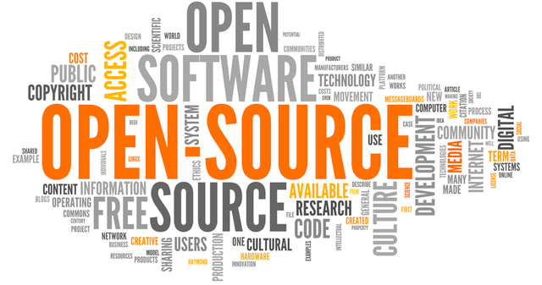
Some course themes
Everything is open-source
All software we use is freely available
Assignments can be completed anytime, anywhere from any OS
Course materials are publicly-available on the internet

Slide 20
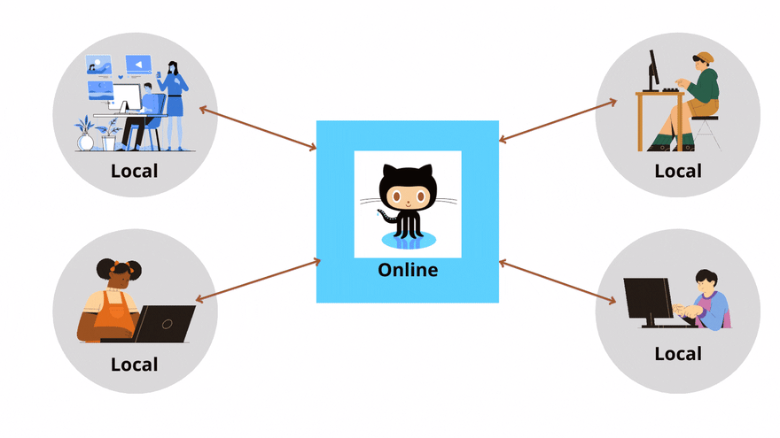
Some course themes
Promote collaboration and communication
With instructors and peers
On GitHub

Slide 21
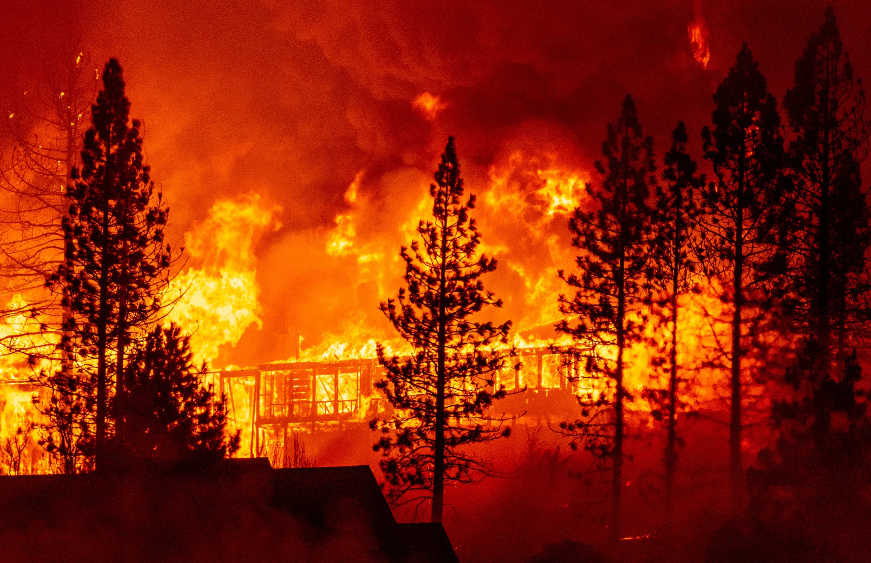
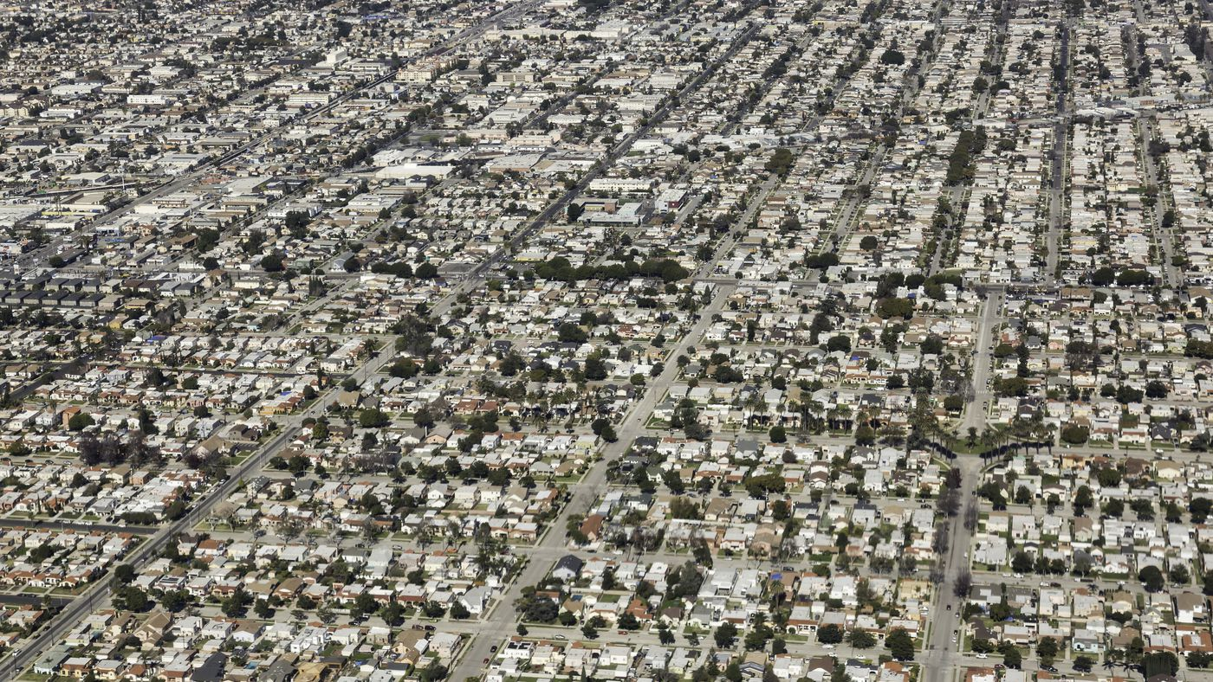
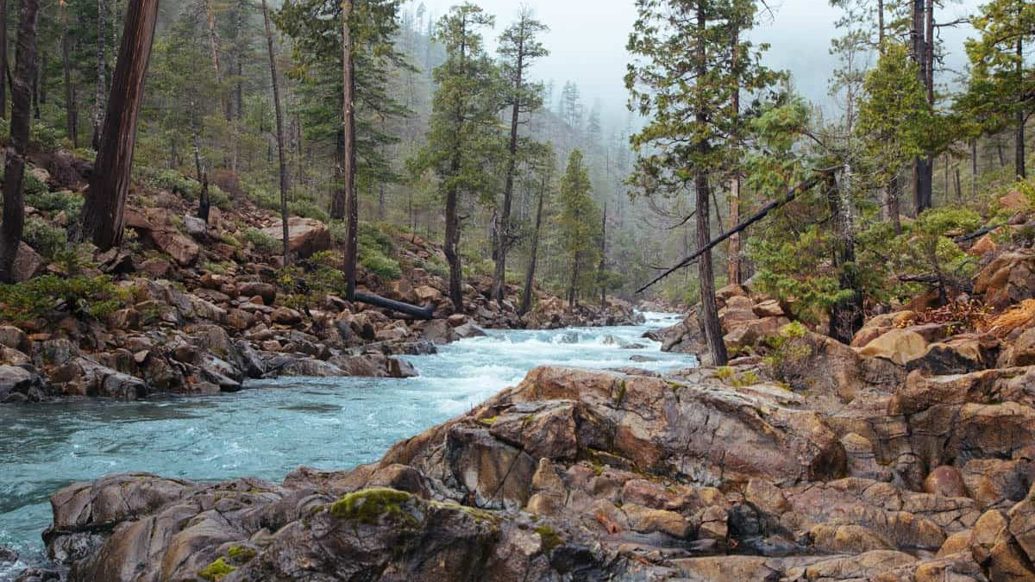
Some course themes
Learn about environmental challenges in the US
Urban planning and zoning
Hazards (e.g. wildfires, flooding)
Energy, climate, hydrology

Slide 22
Some course themes
Don’t try and write perfect code, if it works, it works
It's not always necessary to write code, adapting code is quite normal
Make use of all available resources on the internet
Previously, StackOverflow, now LLMs (policy)
Don't be afraid to ask (peers or instructor)
Notes:
If you’re having a problem, someone has probably also had that problem. Data science is as much about learning how to write the right question in Google rather than remember the right syntax. I haven’t taken a Computer Science course in my life. There are some very good programmers in this class, ask them for help.

Slide 23
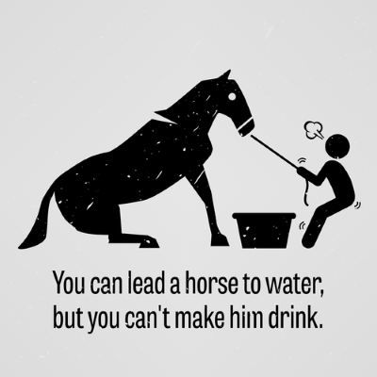
Some course themes
Take responsibility for learning
Organize your files
Check Canvas regularly
Maintain your GitHub profile and repository
Notes:
I am your tour guide to the world of Geospatial Data Science. I can point out things like this is the best way to reproject data using Python. I can answer your questions. But I can’t make you a great programmer. You have to be responsible for you learning.

Slide 24

Some course themes
Notes:
None of this “Hello world” intro to programming stuff. After this week, we will be doing useful things with our code.

Slide 25
By the end of this course you will…
Improve programming skills
Learn how think computationally and statistically
Solve real-world problems using spatial analysis
Run basic machine learning models
Manage a data science project using version control
Collaboratively develop a data science project
Communicate results of data science project orally and as a short write-up

Slide 26
Produce a ”modern” scientific article
Manuscript – final PDF of the paper with citation and DOI
Data availability – hosted on Zenodo or internally, with README describing datasets
Code availability – curated GitHub repository including code for figures, models, and annotated notebooks for replication. Also clearly defined dependencies (e.g. Docker)
Example: https://langnico.github.io/globalcanopyheight/

Slide 27
A “modern” scientific research profile
Web presence!
Examples:
https://github.com/PennyHow
https://github.com/tom-andersson
https://github.com/acocac

Slide 28



Getting started on this week’s homework
Go to course page:
https://ryan-lab-duke.github.io/gds-applications-site/labs/week1/assignment1.html
Also see Canvas for links

Slide 29
Next time:
Lecture 2: Vector data

